Slide 1
Mentor Training Program
A guide for your council
To become a
Stronger and closer knit
Organization!
Presented by:
The Massachusetts State Membership director
Stephen Brenner, F.D.D.
&
William Huber, D.D.

Slide 2
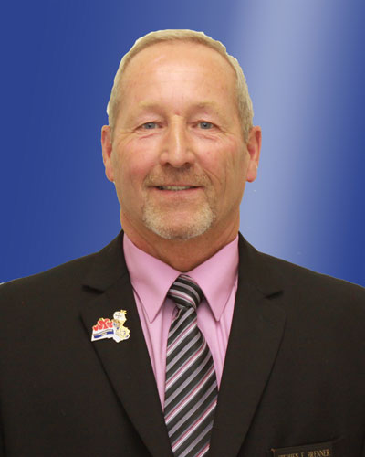
Mentor Training Program
Welcome My brother knights, My name is Stephen Brenner, I’m the state membership director.
Today, I will introduce you to our newest training program. “The mentor training program”
But before I begin, I urge every officer here today, that once you’ve heard this program, take it back to your council. Then, instruct your membership team and members on how to include it with the processing and developing of new candidates so that they might become long time active members and develop into Council leaders.

Slide 3
Mentor Training Program
all too often, we look for candidates that we hope will become knights that will develop into solid leaders within our council!
in the majority of cases we fail to do so. Not because of the quality of the member, but rather in our lack of ability in carrying out our responsibility to these men, when they first come on board.
Therefore, by implementing the new mentor program into your council’s membership program, I believe that you will and can accomplish your leadership goals with any new member!

Slide 4
Mentor Training Program
This program is a simple but effective one. However, you must commit yourself to do the following in order to benefit your council and the member for years to come:
Immediately after his 1st degree, impress upon him, that he has the right to vote at every meeting of his own council.
Get him to his next two meetings, so that he feels he is part of the Council.
Maintaining contact with the new member, particularly in his first six months is very crucial to keeping him.
Get him involved in your council activities will ensure his longevity.

Slide 5
Mentor Training Program
Help him to understand the purpose of our dues structure.
Instruct him in the benefits of bringing in new members himself through the Massachusetts “shining knight award.” in doing so he will help your council growing for years to come. This is what we call the Domino effect!
Once he proposes a new candidate, he can then become the mentor of that individual. Again, By doing this, we will have created a program of perpetual growth and involvement within your council for years to come.

Slide 6
Mentor Training Program
By following this mentor program, we can make the new member feel welcome and get him involved ASAP, within his first six months, we can mold him into the “quality knight” we were looking for originally, active and engaged!
A knight that is active and engaged, helps you to increase the volunteer actions and charitable works of the order. so that we can serve the poor, feed the hungry and shelter the homeless.
This ensures not only the future of your council, but that of our order. It also helps us to grow and keep more catholic families within the church.

Slide 7
Mentor Training Program
Most officers and members believe that the proposer of a new member will be his mentor. True or false?
False! Nothing could be further from the truth. Some members will never ask a man to join because they don’t want that responsibility put upon them.
So, how do the council officers and members, go about getting the “quality knight” that they are looking for?
You do it, by taking the necessary steps to train them and mold them into the “quality Knight” that you were looking for!

Slide 8
Mentor Training Program
a mentor can be any council member, but he should do and know the following:
He should volunteer for the position and that he indicates an interest in helping.
He should know and understand the workings of the council.
He should know and understand the laws and rules of the knights of Columbus.
He should have a current and good attendance record at the council meetings.
Last but not the least, he should be willing to be the new member’s “best Friend” within the council.

Slide 9
Mentor Training Program
Who would coordinate this
mentor training program?
The council chancellor has the honor and responsibility for making new members feel welcome and getting them involved in the council programs. He is the one who coordinates the New “mentor training program.”
How does this work, you might ask?
Let’s move on to the next phase of this training program!

Slide 10
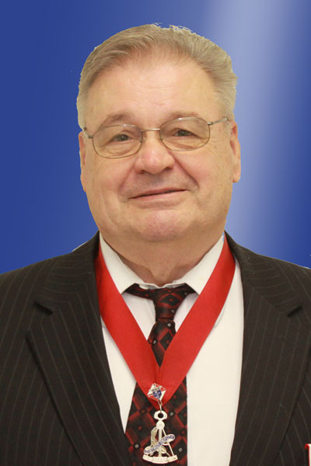
Mentor Training Program
At this point in time, I would like to thank all of you here today, for Your attention and interest in this Program so far, the new “mentor training program.”
Now, It’s my pleasure to introduce you to D.D. Bill Huber, who will continue to help you understand how the mentor training program works in detail!

Slide 11
Mentor Training Program
Again, welcome my brother knights to the second level of training for the
“mentor training program!”
The first thing that a chancellor should ensure is that the candidate makes his first degree within a three to six week period, or earlier. Any thing beyond that timeline, would most likely result in an 85% loss ration of any and all candidates!
Immediately after the first degree, your chancellor needs to formally welcome the new member to the council. This is The first step in making him feel at home and a part of the knights of Columbus fraternity.

Slide 12
Mentor Training Program
Your chancellor should use the
Following script or a similar one!
Welcome Brother (name), I’m pleased that you have decided to join the knights of Columbus, the largest catholic lay organization in the world with more than 1.8 million members.
There are two brothers that I would like to have you meet at this time. On your application to the knights, you indicated that you were interested in (e.g.) working with the youth in our community and therefore, I would like to introduce you to brother (name). He is our youth director and he would like you to join his committee working with the young boys and girls of our area.

Slide 13
Mentor Training Program
For any youth activities that our council might engage in, you can expect that Brother (name) will be contacting you and asking you for your assistance.
Please, Before you leave to go home today, would you leave your telephone and/or cellphone number(s) along with your e-mail address with him so that the two of you will be able to reach one another in a timely fashion.
This will ensure that our youth activities will be covered at all times.
Do you have any questions for our youth director at this time?

Slide 14
Mentor Training Program
Now, the second brother knight that I would like to introduce you to, is Brother (name).
Our council is very fortunate to have several members who have volunteered to be a mentor for new members such as yourself.
Brother (name) has asked and has been appointed to be your mentor for the next six months.
Now, let me explain just exactly what brother (name) is going to do for you and accomplish with you in the very next few weeks!

Slide 15
Mentor Training Program
Brother (name) will:
Ensure that you will both trade telephone and cellphone numbers along with your e-mail address before you leave here today.
He will get in touch with you within the next week to answer any questions that you may have about the degree you took today or anything else that happened here today.
He will also call you within a few days of our next council meeting, to remind you of it and to offer you a ride. Travel with him if you can!

Slide 16
Mentor Training Program
What else will your mentor do for you?
He will pick you up for the 1st and 2nd meetings of our council. (or the next meeting)
He will invite you and your wife to our next council social activity.
He will take you to your major degrees if your sponsor can’t.
He will help you understand why we pay dues.
He will answer any questions you may have about the order.
He will protect you from being elected as the grand knight or deputy grand knight until you have first served as the chancellor. This is part of the succession planning that will ensure that our council gets a more effective grand knight.

Slide 17
Mentor Training Program
Your mentor will also do the following:
He will also give you a state of Massachusetts
“shining Knight Award” card!
requirements of this reward are:
That you have Received your 1st Degree
That you Work on 3 projects (church, community, council, culture of life, family or youth)
meet with the council field agent.
Recruit at least 1 new member (3 for any existing member)
That you Receive your 3rd degree.
All of these items, must be done within the 1st year of your membership!

Slide 18
Mentor Training Program
The Massachusetts “Shining Knight” Award is offered to new members within their 1st year of membership and to those members who have been a knight for greater than 1 year. The member who has been a knight for greater than 1 year, will need to have accomplishments 1 – 3 on the back of the Shining Knight card just as the new member, and sponsor three new members into the order between July 1 and June 30. a member can only earn this award one time.
*please, financial secretaries should have these cards on hand for all the 1st degree members.

Slide 19
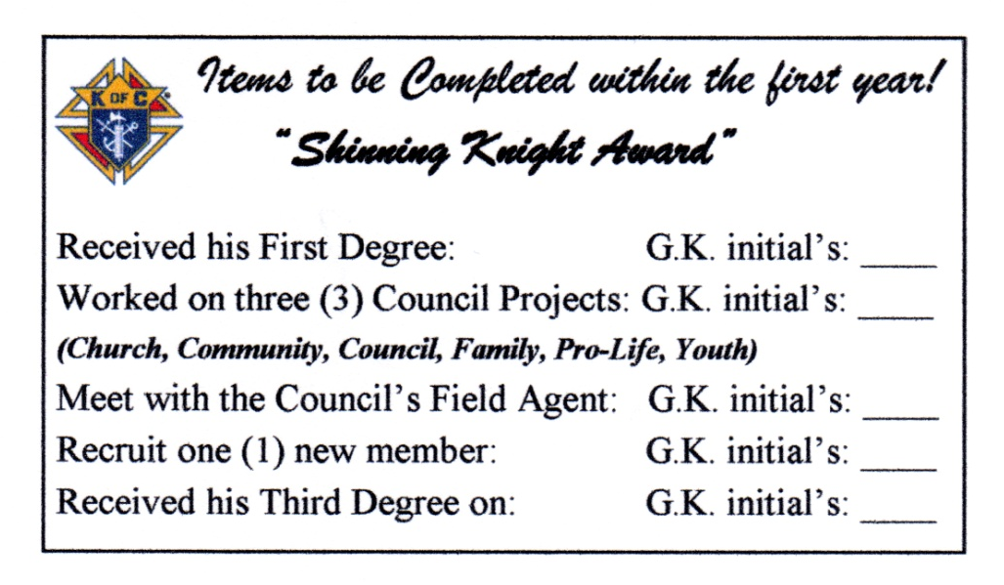
Massachusetts “Shining Knight Award”
Massachusetts state
Knights of Columbus
“Shining knight award” card
Front view of card
2” X 3 ½”
Massachusetts state
Knights of Columbus
“Shining Knight award”
Card
Back view of card

Slide 20
Massachusetts “Shining Knight Award”

Slide 21
Mentor Training Program
Brother, this is our commitment to you. By providing you with a mentor, we are promising you, that your membership in our council, will not only be a rewarding experience, but one that will be a fulfilling experience also.
It is our commitment to you that will ensure that you feel welcome and that we will be here for you and to answer whatever questions you may have.
It is our commitment, to help you get involved not only with the Church, but to help you become a better Catholic, husband and father.

Slide 22
Mentor Training Program
Brother (name), the officers and members of this council want you to know that your not alone.
We are committed to helping you get the most out of your experience with the knights of Columbus!
Now, do you have any other questions at this time, that you would like me to answer for you?
Do you have any thing else that you feel you may need from us at this point in time?
Brother (name), We look forward to moving forward with your mentoring and your association with the Council!

Slide 23
Mentor Training Program
Brothers, these are the basic concepts of the mentoring training program!
each council is free to add to it as long as the intent is preserved!
the care and nurturing of every new member is the responsibility of us all!
remember, once he joins he is your brother! Treat him like one!
ultimately, an active and engaged brother knight ensures that our Church and order will remain strong.
it all begins with making a new member feeling welcome at all times!

Slide 24
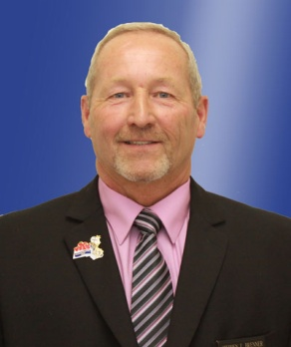
Mentor Training Program
Thank you!
Presented by
The Massachusetts state membership director
F.D.D. Stephen Brenner
And
D.D. William Huber

