Slide 1
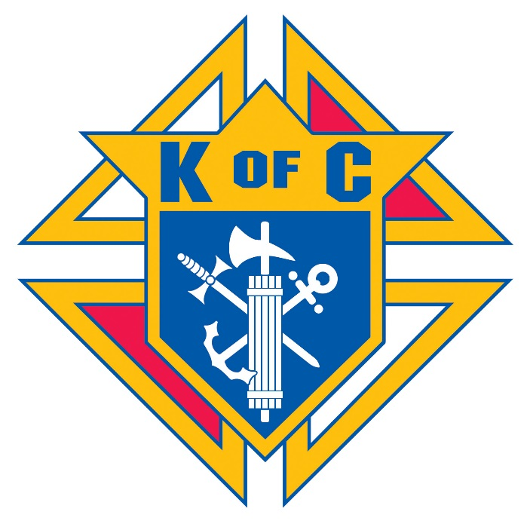
Massachusetts
Knights of Columbus
Membership
State Membership Director Patrick Curley, FDD

Slide 2
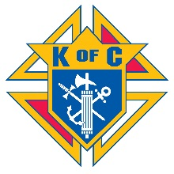


Membership
Our Supreme Knight, Carl Anderson, has stated many times that we have a moral obligation to offer membership in the Knights of Columbus to every eligible Catholic Man.
    This offers them an opportunity to become a better CATHOLIC, FATHER, HUSBAND AND MAN.
    It gives men the chance to support their parish, give back to their community, grow in their faith and gain exclusive access to our top-rated insurance program to protect their family.

Slide 3


Slide 4
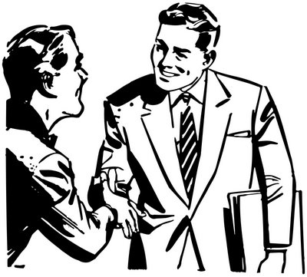
Membership Recruitment
  It is the responsibility of every member of the Order to assist in the recruitment of new members.
    Recruitment is a 12 month, 365 day a year job. WE DON’T TAKE THE SUMMER OFF!
    Ensuring membership growth helps everyone, your Council, State and Supreme.
    At every Council meeting membership should be discussed and plans put in place.
    At every Council meeting Officers should make sure to have form 100s to give to every member in attendance, always carry a form 100 with you!
    Schedule a 1st Degree every month or on a regular basis if possible and make sure the dates and locations are posted on the State website.
    Every member should be tasked with asking at least one person a month to join the Order.
    Men won’t join if we don’t ask them to!
Jack, why aren’t you a member of the Knights?
Pat, no one has ever asked me to join!

Slide 5


Membership Recruitment
  What is recruitment? It’s marketing, pure and simple.
    The best way to entice new members to join is through marketing ourselves.
    We have to convince prospective members that we have something they want and need.
    Councils should let people, especially families in their Parish, know what they are doing and why.
    Have Council specific literature available outlining what you have done in your Parish, community and with the State and Supreme Councils.
    Try to find a contact with your local newspaper and submit stories on what you do and what you’ve done.
    Build a website that contains information on your Council, Council activities and, most importantly, contact information.
    Use social networking such as Facebook, Twitter and your local Patch to spread the word before and after an event.
http:/www.yourcouncil.com

Slide 6

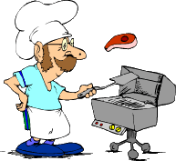
Membership Recruitment
Councils should be as visible in their Parish as possible.
    To entice men from the Parish to join you have to show them what you do to make the Parish and Community a better place.
    Ask the Pastor for permission to always keep K of C informational literature in the Church.
    Inquire about having a permanent presence in the Parish bulletin. At the very least ask that contact information be included.
    Be sure that the Pastor knows he can call on the Council for help and will receive it.
    When doing a project for the Parish or Church be sure everyone is in K of C shirts or hats and, if appropriate, have the Council banner displayed. Always have a membership table set up and manned at any event or project your Council is involved with.
    Before starting a project for the Parish, ask men who are not members if they would like to help. This is a great way for prospective members to meet members of the Council and see first hand what we do and why we do it.

Slide 7
Membership Drives
Councils should run 4 Church Membership Drives each year, one each quarter. Church drives allow you to reach a large audience of your best prospects for membership, Catholic men attending Mass.
    Speak to the Pastor and receive permission to hold a Church Membership Drive.
    Set a date that is acceptable to the Pastor, give yourself time to thoroughly plan for the drive.
    Order a Blitz kit from Supreme, create a Council specific brochure or brag sheet.
    Put together brochure “packets” to hand out. They should include the Council’s brochure, a couple of brochures from Supreme, a form 100 and a prospect card with contact info included.
    Be sure to have enough members to cover all the doors of the Church at all Masses.
    Arrange for someone to speak at all Masses for 3 to 5 minutes, a Council Officer, District Deputy, a member of the Membership team or your Field Agent.
    If possible arrange to have a bulletin announcement for 2 weeks before your drive, informing people that the Knights will be recruiting. Post the date, times and location on the Council website, Facebook page, Patch.com and local paper.
    Arrange for members of the 4th Degree Honor Guard be present in regalia, it gets people’s attention.
    Schedule an Open House and 1st Degree for the 2 weeks after the Drive.

Slide 8
Membership Drives
Once you’ve completed the preparation phase for the Church Drive you need to make sure it’s run correctly. You have a small window to reach people as they are dashing out to their cars.
    Make sure members are given instructions and that they know what is expected of them.
    Have a table set up with information and, if possible, a tri fold or similar board with pictures.
    Have at least one member at every door. If there are 4 doors and you cover 3, everyone is leaving by that 4th. Don’t wait until the Mass is over to man the doors, you want to catch those leaving early too!
    Members should hand out the “packets” to every man over 18 leaving the church. You go to them, don’t wait for them to come to you. If women want the info as well, no problem!
    If you can, have potential members fill out a prospect card or form 100 on the spot, that’s best.
    Members should be prepared to answer questions about the Order and your Council. They should know the location, dates and times of the Open House and 1st Degree.

Slide 9

Council #1078
July 1, 2015
7:00 pm
All Catholic men and their families are welcome
Membership Open House
Once you’ve completed the Drive you need to follow up and hold an Open House.
    Contact any prospects that you have contact information for.
    Plan your Open House. Name a coordinator to make sure the Open House runs smoothly.
    Ask the Pastor to advertise the date, time and location of the Open House in the bulletin.
    Invite not only prospective members but their wives and children too.
    Invite the Pastor to speak at the Open House.
    Invite the Field Agent to speak as well.
    Plan to show some of the short videos from Supreme, either on a screen or large TV.
    Serve refreshments.
    Have an Officer, District Deputy or Membership Team member speak on what your Council and the Order as a whole have to offer to the prospects and their families.
We want you and your family to help us to make the world a better place!
Knights of Columbus

Slide 10
Membership Recruitment
Once you’ve completed the Open House, plan on having a 1st Degree the next week.
    Contact all of your prospects and personally invite them to the 1st Degree.
    Offer to provide them with transportation to and from the Degree.
    If a prospect cannot attend your 1st Degree, find one in the area as soon as possible and offer to accompany him to the Degree.
    Once the 1st Degree is completed, promptly file the form 100s with Supreme.
    Inform your new members of the schedule of 2nd and 3rd Degrees in your area.
    Make sure that their proposer, an Officer or member accompany the member to their 2nd and 3rd Degrees. Candidates should never attend a Degree alone, you should always have someone there to support them.
    Now is the time to contact the Pastor and set a date for your next Membership Drive!

Slide 11
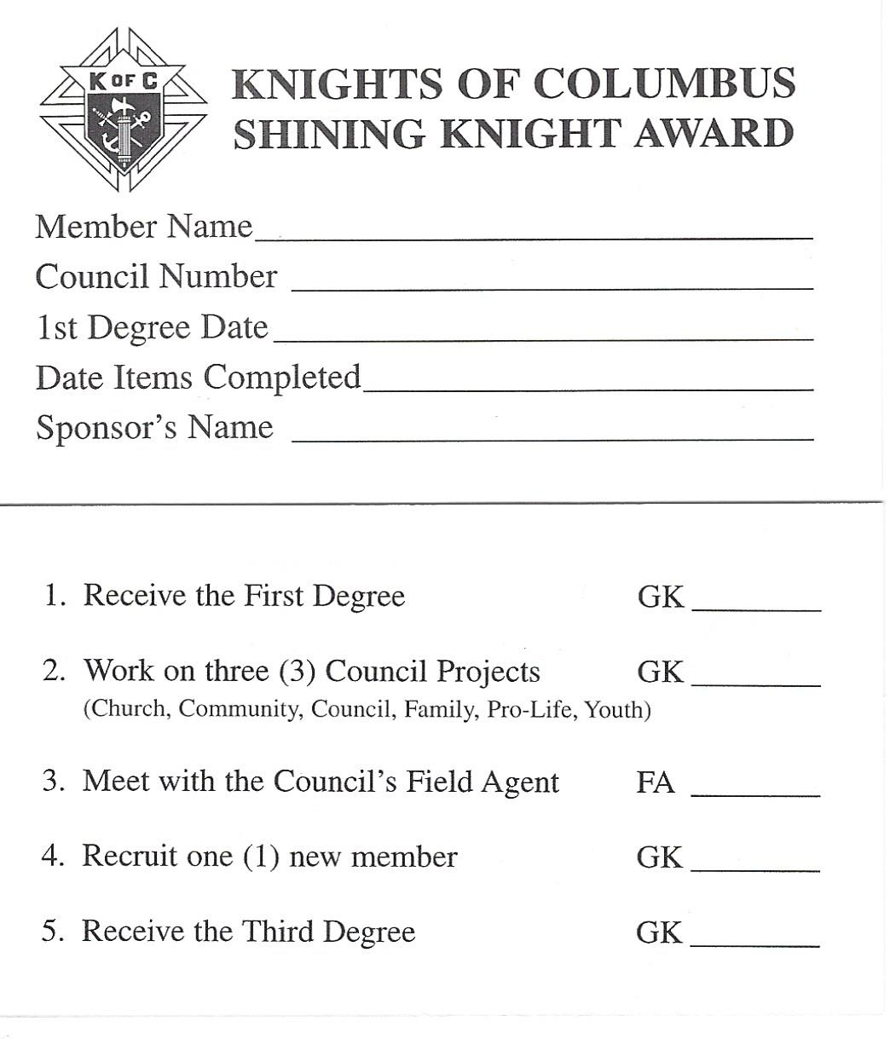
Shining Knight Award
As an incentive for new members to become involved in recruitment and programs the State Council offers the Shining Knight Award. This prestigious award is presented by the State Deputy or his representative. At every 1st Degree, someone, the District Deputy, a member of the Membership team or a member of the Council should give these cards, along with a form 100, to the new members and explain the requirements.
To earn the award the new member, should, within 12 months:
    Receive his 1st Degree
    Work on 3 Council Projects
    Meet with the Council’s Field Agent
    Recruit 1 new member
    Receive the 3rd Degree
    Existing members can receive the award fulfilling the same
    requirements in a 12 month period but they must recruit 3
    new members.

Slide 12
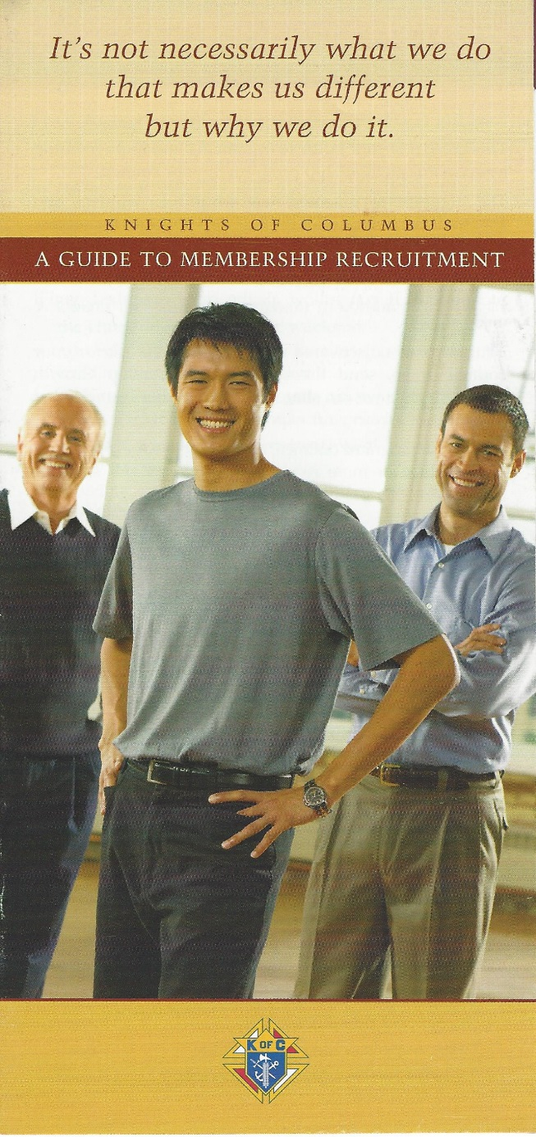
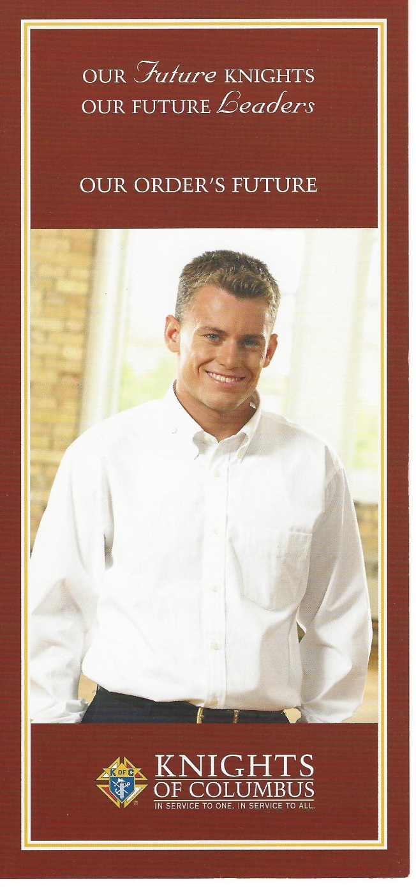
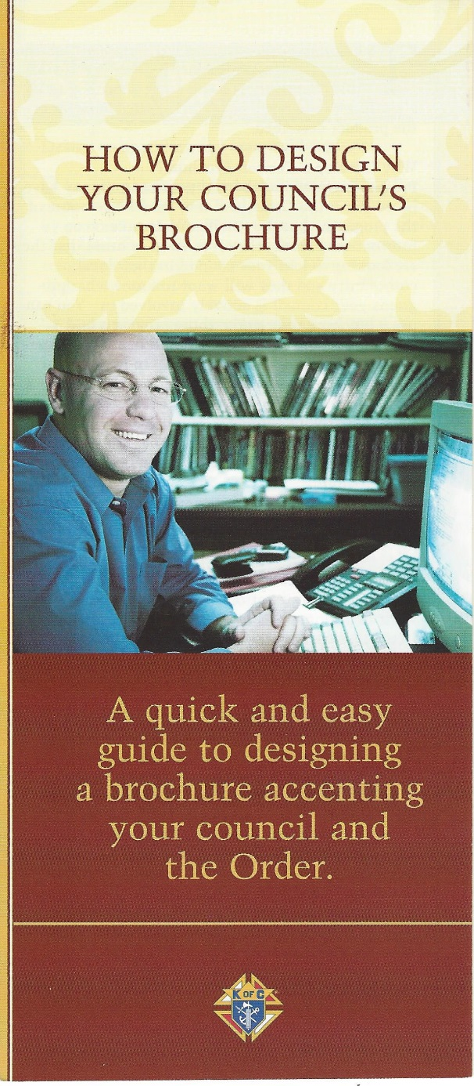
Brochure # 2769
Brochure # 9116
Brochure #4125
These brochures, available from Supreme or myself, are great resources…order some today!

Slide 13
Membership Retention
Now that you have brought in a new member, you have to keep him!
    Retention begins before the 1st Degree!
    Assign a knowledgeable member of the Council to mentor each candidate or new member.
    Make your new member feel welcome at meetings and events.
    Find out what the new member’s interests are.
    Determine where and with who he’ll best fit in.
    GET HIM INVOLVED AT MEETINGS, PROGRAMS AND EVENTS!
    If you don’t get him involved he has no reason to stay and will eventually leave the Order.

Slide 14
Membership Retention
Always look for the “warning signs” that indicate you may be losing a member. Marked decline in meeting attendance and committee involvement among formerly active members is a sign of lost interest. Although these members may have compelling reasons for reducing the amount of time they give, do not give up on them.
    Handle such members with tact and consideration.
    Make missing members feel valued and needed by asking them to take on a task that "only they can do," one which their experience truly counts.
    Ask them to give just a small amount of their time to one particular project. Explain that their contribution is very important.
    Take time to say thanks.
    Honor members with a luncheon, ceremony, award or certificate in recognition of their years of involvement and service.
    Remember that retaining a member is easier than recruiting a new member!

Slide 15

Star Council
Father McGivney Award
Membership Quota
7% of current membership
Or Minimum of 4
Maximum of 35
Service Program Personnel
Report
Form #365
Due – August 1st
Founders’ Award
Insurance Quota
2.5% of current membership
Or Minimum of 3
Maximum of 18
Columbian Award
Report Form #SP7
Due – June 30th
Good Standing
Current with all Supreme Council assessments - as of June 30th of the fraternal year
Annual Survey of
Fraternal Activity
Report Form #1728
Due – January 31st
Multiple Stars
Earn Two Star by attaining 200%
Earn Three Star by attaining 300%
Earn Four Star by attaining 400%

Slide 16
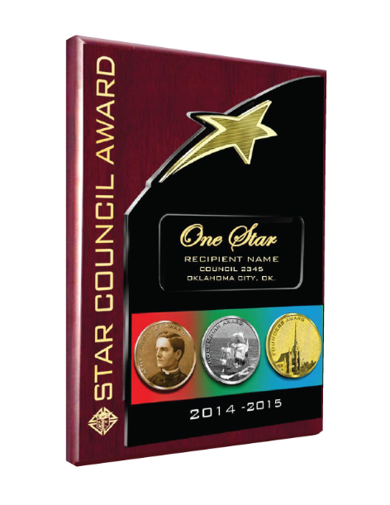
Star Council
Now that you’ve held your Church Drives, Open Houses and recruited new members, you’re well on your way to earning the Star Council Award!
Every Council has the potential to be a Star Council.
To earn the Star Council Award:
    A Council must have submitted its Survey of Fraternal Activity (#1728) and its Service Program Personnel Report (#365) and be in Good Financial Standing.

Slide 17

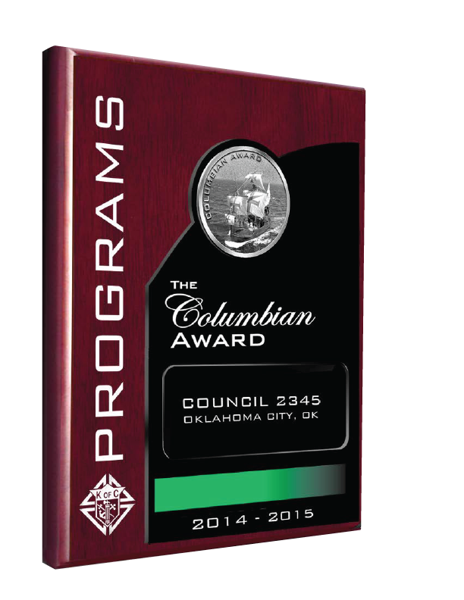
Star Council
Earn the Columbian Award for programs.
    Complete and submit the Columbian Award Application (SP7).
    Councils must conduct and report at least four major programs in each of the Service Program categories: Church, community, Council, family, culture of life, and youth.
    Completed applications must reach the Supreme Council office by June 30.
    Each of the six Columbian Award categories also has at least one featured program. By meeting all requirements for a featured program activity in a particular category, a Council fulfills all requirements for that category.

Slide 18
Star Council
The six categories, featured programs and minimum requirements for each are:
    Church - The featured program for the church category is the Refund Supports Vocation Program (RSVP), a Council must qualify for the RSVP refund and plaque for a minimum of one seminarian, by providing both financial and moral support.
    Community - There are two featured programs, Habitat for Humanity, a Council must donate both $1,000 and 200 man hours to Habitat for Humanity, and the Global Wheelchair Mission, a Council must purchase a minimum of one case of 100 wheelchairs by raising the funds through Council, parish or community activities.
    Council - The featured program for the Council program category is Special Olympics, Council members must contribute a minimum of 200 man-hours in support of state/local Special Olympics activities, and must raise, through Council or parish activities, a minimum of $2000 for Special Olympics.

Slide 19
Star Council
    Family - The featured program for the Family Activities category is the Knights of Columbus Food for Families program, a Council must collect and donate a minimum of 1,000 pounds of food and Council members must contribute a minimum of 100 man-hours in the program.
    Culture of Life - A Council can satisfy all requirements for the Culture of Life Activities category by participating in either the Knights of Columbus Ultrasound Initiative, a council must raise half the purchase price of the ultrasound machine through council, parish or community activities, or a March for Life, as part of an organized program of the Council, with community and parish participation, a minimum of 100 marchers must participate in a national, state or local March for Life.
    Youth - Participating in the Knights of Columbus Coats for Kids program meets all requirements in the Youth Activities category, a Council must purchase and donate to needy children a minimum of 8 cases of coats.

Slide 20
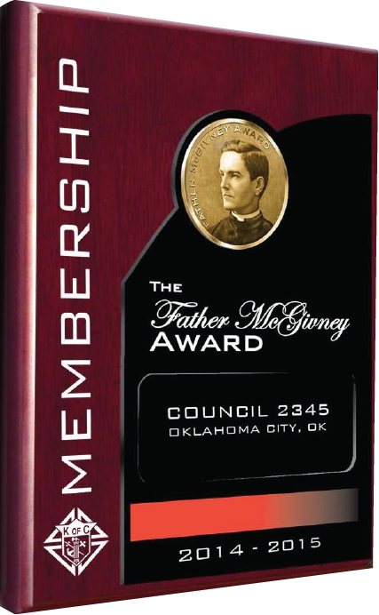

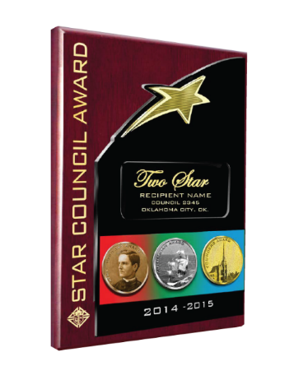
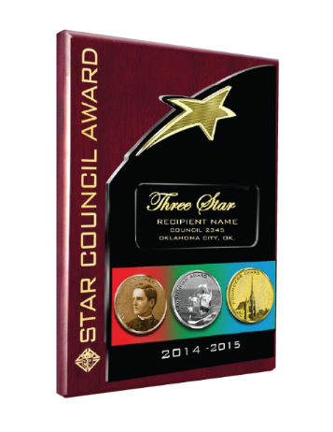
Star Council
Earn the Father McGivney Award by achieving your membership quota.
    The quota for Councils is a 7 percent net increase of the council's membership as of July 1. The minimum quota is 4 and the maximum is 35.
    Councils that attain Star Council status and achieve 200 percent of their net gain goal will receive the Double Star Council Award.
    If they achieve 300 percent of their net gain goal they will receive the Triple Star Council Award.

Slide 21
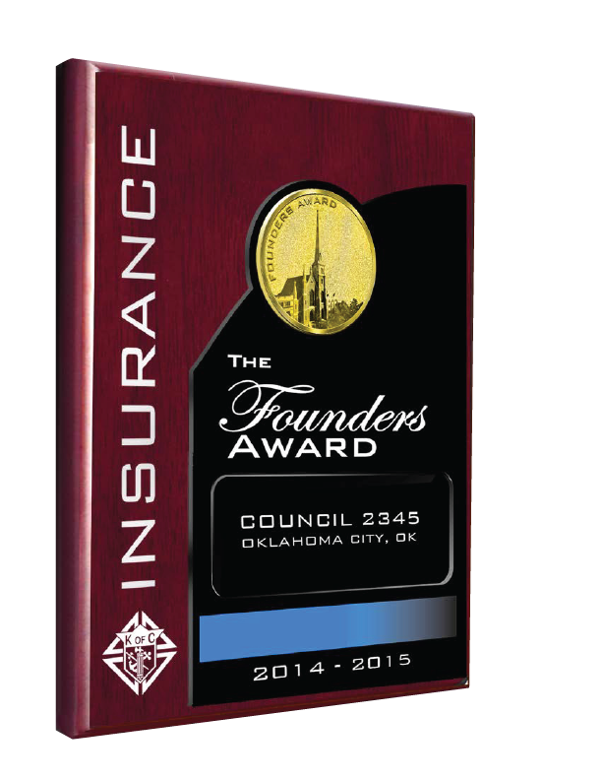
Star Council
Earn the Founders’ Award for achieving your insurance membership quota.
    The quota for Councils is a 2.5 percent net increase in insurance membership as of July 1 for the fraternal year.
    The minimum quota is 3 and the maximum of 18.
    Work with your Field Agent and make sure he is aware of any 1st Degrees that you have candidates attending.

Slide 22


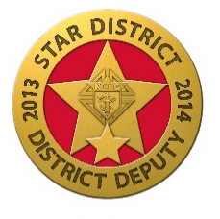
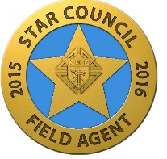
Grand Knight
Membership Director
Program Director
District Deputies
Agents

Slide 23
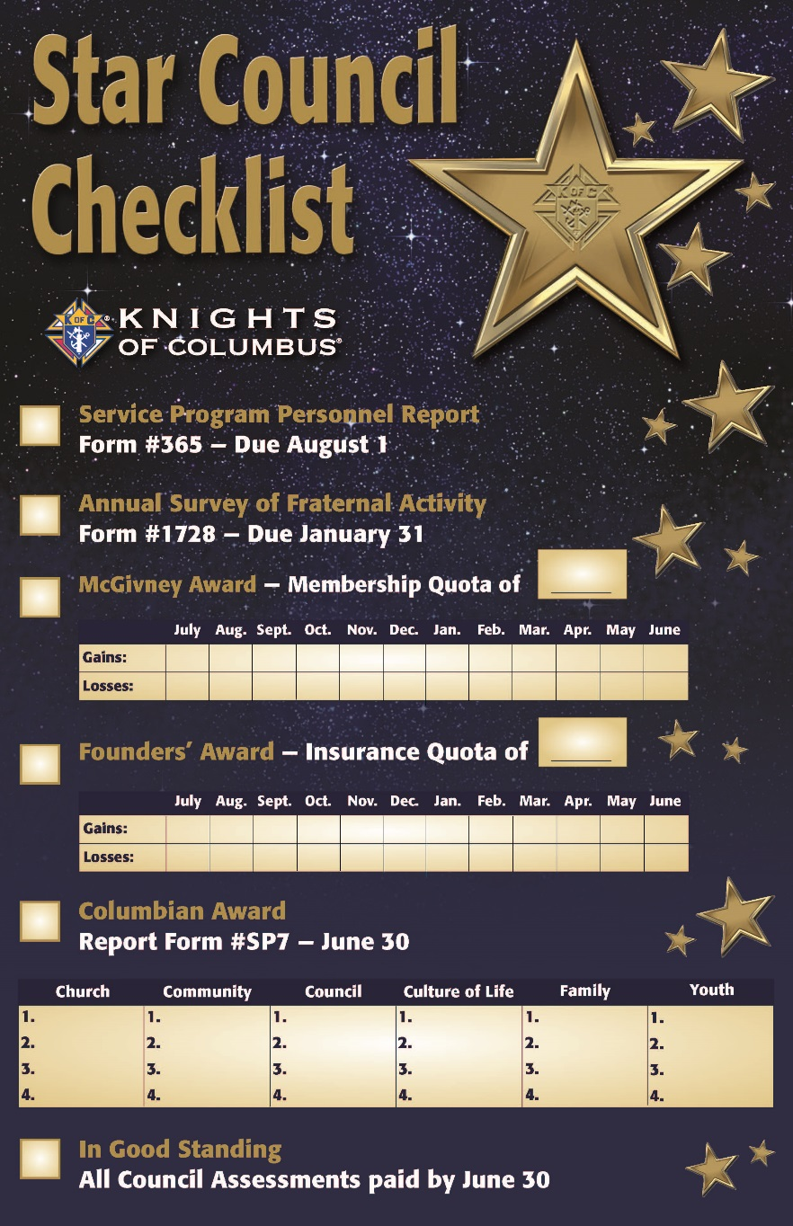
Star Council
Keep track of your progress throughout the year with the Star Council Checklist.
    Post the checklist in a conspicuous place so that every member can see what progress is being made toward Star Council.
    Mark your Council’s progress on a regular basis.

Slide 24
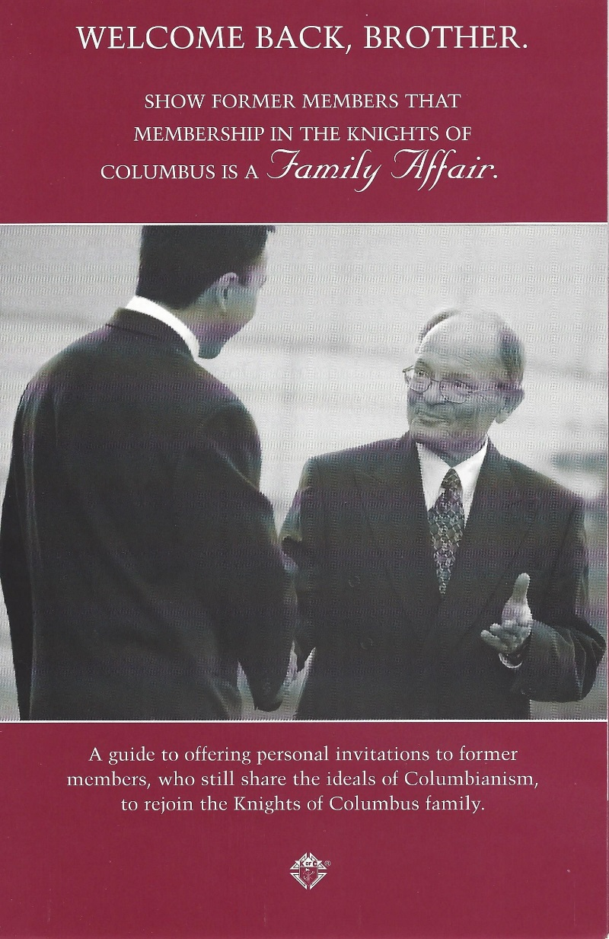
Welcome Back, Brother Program
Brochure # 2689

Slide 25
Welcome Back, Brother Program
Former Knights are men who are familiar with the ideals of Columbianism. They left the Order at one time but represent a pool of prospects that councils should not overlook in striving for membership growth. This can be especially helpful when, at the end of the year, you may be one or two members shy of your quota.
    Appoint a special “Welcome Back Brother” committee specifically to recruit former members.
    Past Grand Knights familiar with circumstances of earlier departures are especially suited to serve on this committee.
    Obtain a list of “Former Members” (those who took withdrawals/suspensions) and “Inactive Insurance Members” (those who took withdrawals/suspensions but maintain K of C insurance policies) from your District Deputy. Check with your Financial Secretary for additional names and most recent addresses.
    Review the list to determine former members known to be residing in the area who are eligible for membership.
    Prepare information for a presentation for former members highlighting changes, new programs/activities/benefits and recent Council achievements.
    Order recruitment materials from knightsgear.com. Prepare kits of materials for distribution.

Slide 26
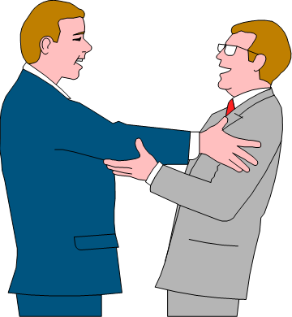
Welcome Back, Brother Program
    Contact each former member by phone to arrange a personal visit or invite them to a reception for former members.
    If conducting personal visits, tailor presentations to highlight new changes/benefits, etc.
    If planning a “Welcome Back” or former-member reception, use the open house procedures. Be sure to invite your Council Chaplain and Field Agent to speak at the event.
    Ask every former member visited or those at the reception to sign a form 100 to renew membership.
    Reactivating inactive insurance members counts as an addition for both membership and insurance quotas toward earning the Father McGivney and Founders’ Awards.
    Reinstatements, readmissions or reapplications of associate members counts as membership additions for the Father McGivney Award.

Slide 27
Why should you and every member of the Order be proud to be a Knight and eager to share that experience with others?

Slide 28


Slide 29
“Don’t worry, the Knights of Columbus will be there.”

Slide 30
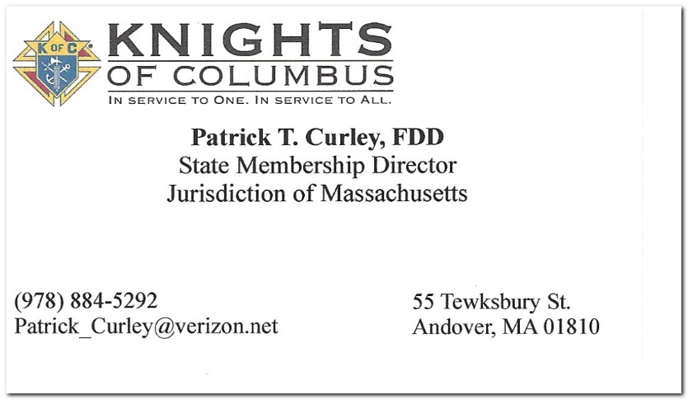
We Are Here To Help!
The State Membership Team is here to help you with any aspect of Recruitment, Retention, New Council Development or Council Reactivation.
Please don’t hesitate to call upon us for help!
We will:
    Assist with Church Drives, we’ll help you prepare, speak at Masses and hand out literature.
    Come to your Council to speak about Membership.
    Work with your Officers on Retention.
    Attend Degrees and speak on the Shining Knight Award.

